Slide 1
MAN & MEDICINE
By
Dr. Reshma Reghu,
Lecturer,
Dept. Of Community Medicine

Slide 2
Millenium Development Goals
To eradicate poverty & hunger
To achieve universal primary Education
To promote gender equality & empower women
To reduce child mortality
To improve maternal health
To combat HIV/AIDS, malaria & other disease
To ensure environmental sustainability
To develop global paternership for development

Slide 3
Goal of Modern medicine
Not only treatment for sickness
Prevention of disease
Promotion of health
Improvement of quality of life of individuals & groups

Slide 4
Medicine in Antiquity
Primitive medicine
Indian medicine
Chinese medicine
Egyptian medicine
Mesopotamian medicine
Greek medicine
Roman medicine

Slide 5
PRIMITIVE MEDICINE
Born out of necessity
Supernatural theory
Pre-historic period intermingled with superstition, religion, magic etc

Slide 6
INDIAN MEDICINE
Indian in origin- AYURVEDA & SIDDHA
AYURVEDA :
Knowledge of life
Origin 5000 B.C
Branch of ATHARVAVEDA
GOD OF MEDICINE – DHANVANTHRI
Authorities in Ayurvedic Medicine:
Atreya
Charaka
Susruta

Slide 7
AYURVEDA
ATREYA
800 B.C
First Indian physician & teacher lived in the University of Takshashila

Slide 8
CHARAKA (200 A.D)
Court physician to king Kanishka
Book compiled “CHARAKA SAMHITA” based on the teachings of Atreya & Charaka mention 500 drugs

Slide 9
SUSRUTA (800B.C - 400 A.D)
Father of Indian Surgery
Book compiled “Susruta samhita” about the surgical knowledge of his time.
British learned the art of Rhinoplasty

Slide 10
AYURVEDA
Tridosha theory of disease
VADA (wind)
PITTA (gall)
KAPHA (mucus)
Law of Manu
Golden age – 800 B.C to 600 A.D

Slide 11
SIDDHA MEDICINE
Tamil speaking areas of South India
Differ very little from Ayurveda in Theory & Practise

Slide 12
CHINESE MEDICINE (2700 B.C)
World’s first organised body of medicine
2 PRINCIPLE:
YANG-active masculine principle
YIN- feminine principle
Early pioneers of immunisation
“Great doctor is one who treats not someone who is already ill but someone not yet ill”
Chinese system of barefoot doctors & Accupuncture

Slide 13
EGYPTIAN MEDICINE (2000 B. C)
Invented pcture writing & recorded on PAPYRUS
Art of medicine mingled with Religion
Strict preservation of Human body
Reached peaks during the days of Imhotep
Speacialisation
Belief : Disease is due to absorption of harmful substance from intestine give rise to putrefaction of blood & formation of pus. They believed pulse as speech of heart.
Disease were treated with Enema, Blood letting etc.

Slide 14
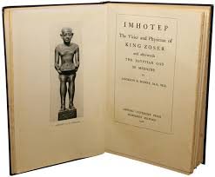
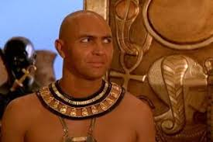
IMHOTEP
2800 B.C
Famous as statesman, architect, builder of step pyramid at Saqqarah & physician
Doctor as well as divinity

Slide 15
EGYPTIAN MEDICINE contd.
Best known medical manuscripts
EDWIN SMITH PAPYRUS
(3000-2500 B.C ) describes about cerebral lesions in skull & Fractures
EBERS PAPYRUS (1150 B.C) records of 800 prescriptions based on 700 drugs.

Slide 16
EGYPTIAN MEDICINE contd.
Public health is excelled
God of Health – Horus
Occupies dominant place about 2500 years.

Slide 17
MESOPOTAMIAN MEDICINE
Civilisation lies between Euphrates & Tigris river called as cradle of civilization.(6000 years ago)
Concept of medicine- Religious & Necromancy
Cause of disease- Demons
Prescription in tablets & cuneiform writings
HAMMURABI, king of Babbylon formulated the code of Hammurabi
Medicine was devoid of scientific foundation.

Slide 18
GREEK MEDICINE
Classic period 460- 136 B.C
To think WHY & HOW
Leaders of Greek Medicine
AESCULAPIUS (1200 B.C)
HIPPOCRATES (460 – 370 B.C)
Believed in 4 elements
Earth Phlegm
Air Yellow bile
Fire Blood
Water Black bile
Outstanding among post hippocratic medical centres , Alexandria’s Huge Museum

Slide 19
AESCULAPIUS (1200 B.C)
Bore 2 daughters
HYGIEA- Goddess of health
PANACEA- Goddess of medicine
Symbol of medicine- His staff entwined by a serpent

Slide 20
HIPPOCRATES (460- 370 B.C)
Father of Medicine
Born in island of Cos, Aegean Sea
Classsified disease based on Observation & Reason
Initiated a new approach to medicine
His writings & lectueres are compiled later by Alexandrian school into Corpus Hippocraticum- 72 volumes- first scientific clinical case histories
Hippocratic Oath – key stone of Medical Ethics

Slide 21
ROMAN MEDICINE
Borrowed from Greek
More practical minded people than Greek
Keen sense of sanitation, sewers, fine roads, aqueducts, pure water etc..

Slide 22
GALEN ( 130- 205 A.D)
Born in Greek city of Pergamon in Asia Minor ( Turkey)
Physician to Roman Empire, Marcus Aurelias
Contribution- Comparative Anatomy & Experimental Physiology
Galen’s Observation 3 factors of disease
Pre disposing
Exciting
Environmental

Slide 23
MIDDLE AGES
Period between 500 -1500 A.D
Dark Ages of Medicine
Arabs stole a march of civilisation & translated Greeco Roman literature into Arabic & their own system as Unani System of Medicine
Leaders in Arabian Medicine were
Abu Becr- Rhazes
Ibn-sina - Avicenna
Arabs greatest contribution is Pharmacology
Golden age of Arabic medicine 800- 1300 A.D

Slide 24
Abu becr
Called as Rhazes
Director of Large hopital in Baghdad
First one to observe the pupillary reaction to light
Used mercurial purgatives
First known book on Children’s disease
First book distinguishes smallpox & measles clinically
Compiled 21 volume encyclopedia “Canon of Medicine”Responsible for elevating Islamic Medicine to its zenith in Middle Ages

Slide 25
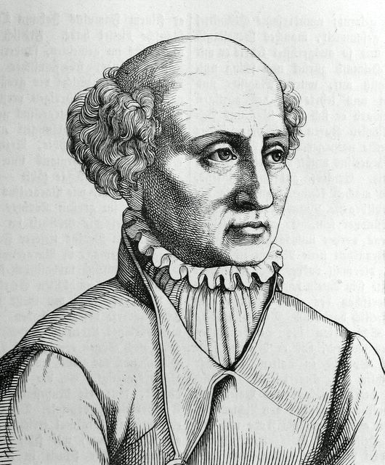
DAWN OF SCIENTIFIC MEDICINE
Period followed by 1500 A.D marked by revolutions
REVIVAL OF MEDICINE (1453- 1600 A.D)
PARACELSUS (1493- 1541)
Swiss alchemist
Turned medicine towards
rational research

Slide 26
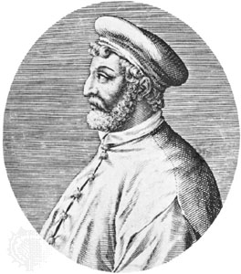
Fracastorius (1483- 1553)
Italian physician
Founder of Epidemiology
Enunciated the Theory of Contagion
Envisaged the transfer of
infection
Cause of Epidemics
Transmit of syphilis by sexual
relation

Slide 27
ANDREAS VASALIUS
1514- 1564
Dissection in human body
Demonstrated Galen’s error
First man of modern medicine
Great work “Fabrica”

Slide 28
AMBROISE PARE (1510- 1590)
French surgeon
Father of Surgery
Advanced the art of surgery
JOHN HUNTER (1728- 1793)
Taught the science of surgery
THOMAS SYDENHAM (1624- 1689)
English Hippocrates
Clinical methods
D/D of scarlet fever, malaria, Dysentry, cholera

Slide 29
17th & 18th Centuries
Period of discoveries
1628- William Harvey- circulation of blood
1670- Leeuwenhoek’s microscope
1796- Jenner- vaccination against smallpox
19th Century- Morgagni- New branch of medical science- Pathologic Anatomy

Slide 30
SANITORY AWAKENING
Mid 19th century in England
Modify behaviour of people & Public Health
Industrial Revolution - 18th century
Slums
Overcrowding
Increase sick Rate & Death rate
Accumulation of filth
Infectious diseases
Frequent attack of cholera
A great cholera attack in 1832 led Ewin Chadwick, a lawyer in England investigate the health of inhabitants- to improve the public health- anti-filth crusade- The great sanitary Awakening-enactment of Public Health Act of 1848 in England.

Slide 31
RISE OF PUBLIC HEALTH
1840- Health concept in England
19th century- father of public health
JOHN SNOW- Polluted drinking water- spread of cholera
1875- Public Health Act of 1875- Man’s physical Environment
Beginning of 20th century- clean water
clean surrounding
control of offensive trades

Slide 32
GERM THEORY OF DISEASE
1860- French Bacteriologist- Louis Pasteur- bacteria in air
1873- he advanced Germ Theory of disease
1877- Robert Koch- anthrax- bacteria
Both confirmed BACTERIOLOGY
Golden Age of Bacteriology
1847- Gonococcus
1880- Typhoid bacilli, Pneumococcus
1882- Tubercle bacilli
1883- Vibrio cholerae
1884- Diptheria bacilli
Turning point in Aetiological concept & Theory of disease of Causation

Slide 33
BIRTH OF PREVENTIVE MEDICINE
JAMES LIND- Scurvy- intake of fruits & Vegetables- 1753
EDWARD JENNER- vacination for small pox – 1796
After theory of causation, 19th century –discoveries
Pasteur’s anti rabies treatment- 1883
Cholera vaccine- 1892
Diptheria anti toxin- 1894
Anti typhoid vaccine- 1898
Antiseptic & Disinfectant
Furthur advance in mode of transmission
1898- Ross- Malaria- Anopheles mosquito
1900- Yellow Fever- Aedes
After Bacteriology, blocking the channel of Transmission
Water purification
Sewagw disposal
Vector control

